Slide 1
Capstone Project: Car accident severity
October 2020

Slide 2
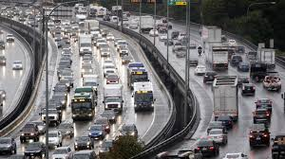
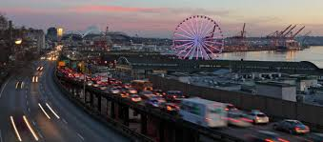
Introduction
For the final Capstone project, we aim to understand what are the factors affecting severity of car accident using various data science techniques we have learned.
Data from Seattle Traffic Management has been used in this study to understand the various factors which play part.

Slide 3
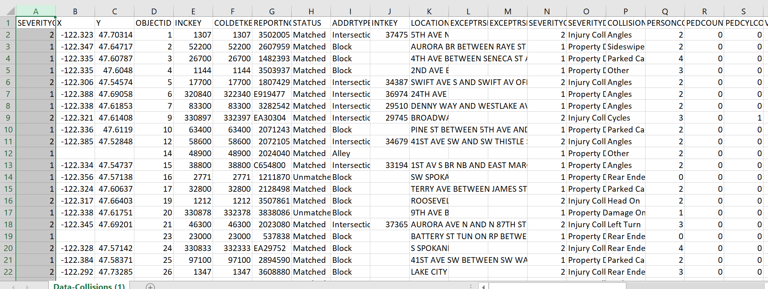
Data Description
The data is provided by SDOT Traffic management division which include all car collisions from 2004 to present in Seattle and has been updated weekly.
The data consists of 38 columns (parameters) and 194673 entries, each entry represent one accident.
From the Metadata file, we get an understanding of the various attributes which may contribute to the target variable: severity of the car accident (SEVERITYCODE ) The definition of the severity codes are provided in the metadata and shown below.
Severity Code | Meaning
0 | Unknown
1 | Prop damage
2 | Injury
2b | Serious injury
3 | Fatality

Slide 4
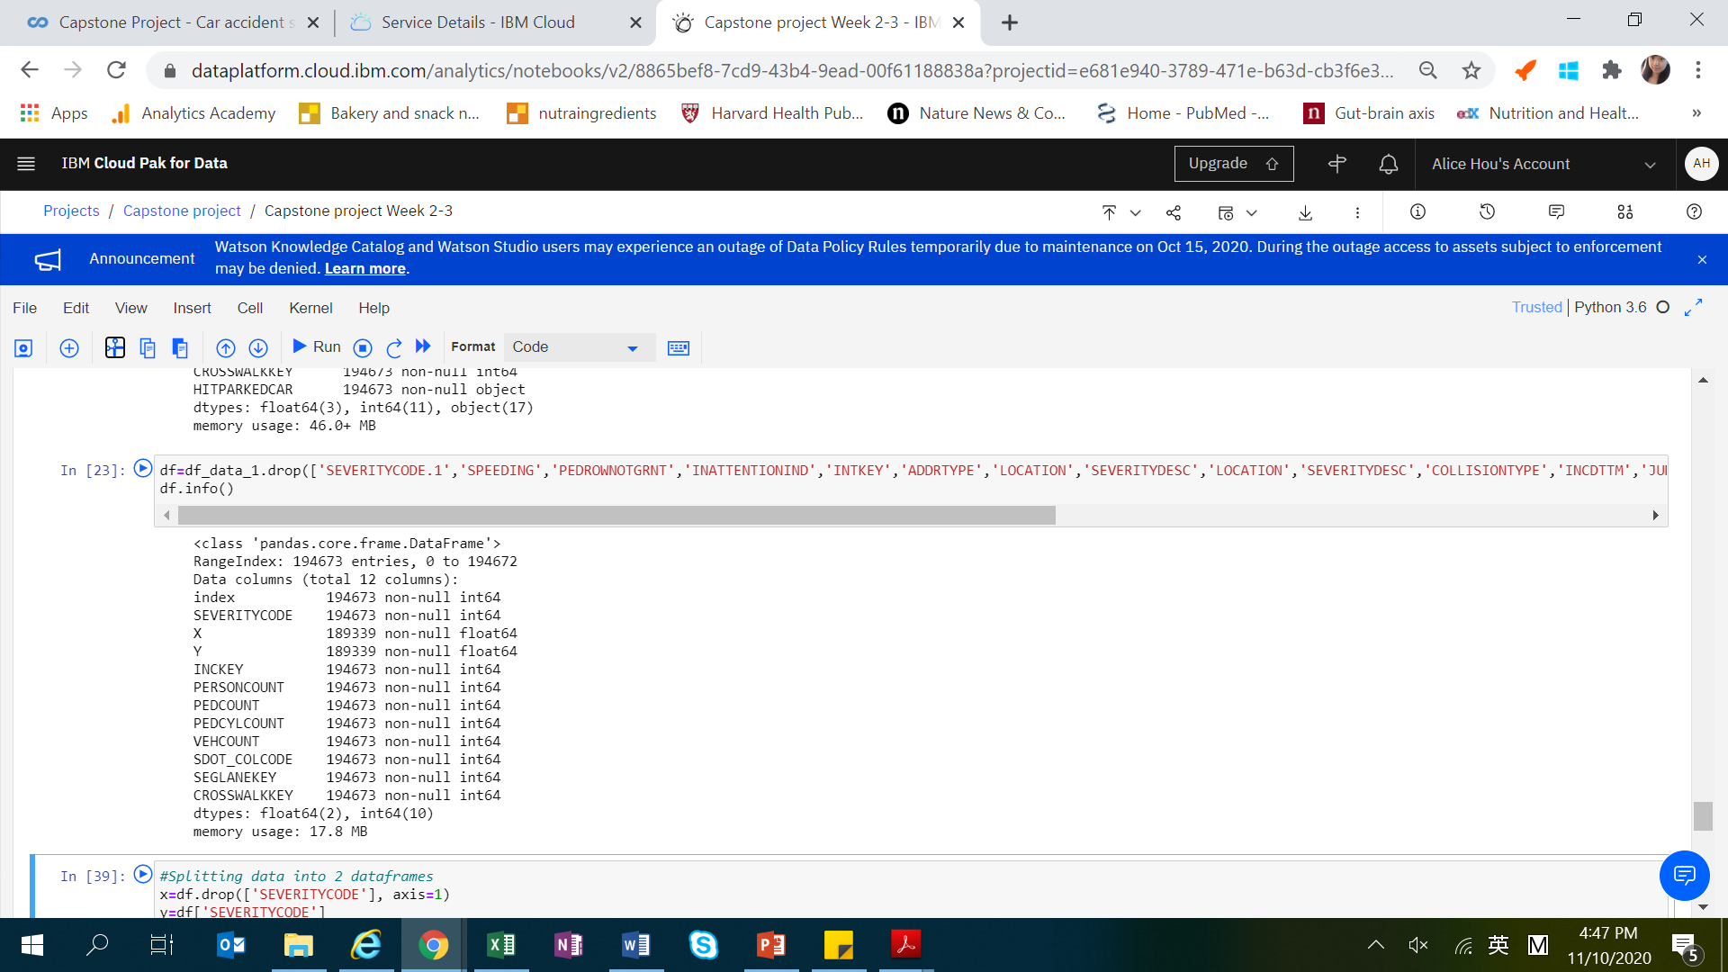
Data clean-up
In the original dataset, there are a number of missing values, redundant columns, missing values and many columns are categorical valuables.
We have carried out a series of clean-up process to render the data suitable for next step analysis.
We removed 8 columns which contain unnecessary/redundant information.
We removed rows with missing values
We dropped columns with high number of missing values
The categorical variables have been removed as well.
Final data consist of 12 columns and 194673 entries.

Slide 5
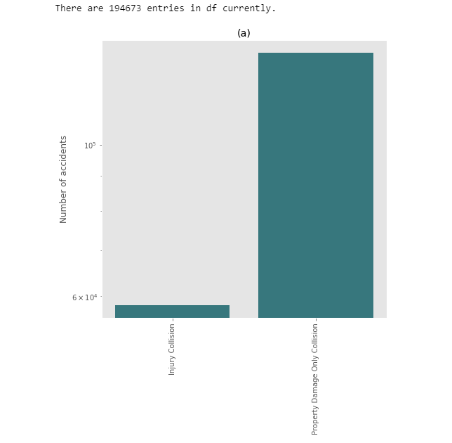
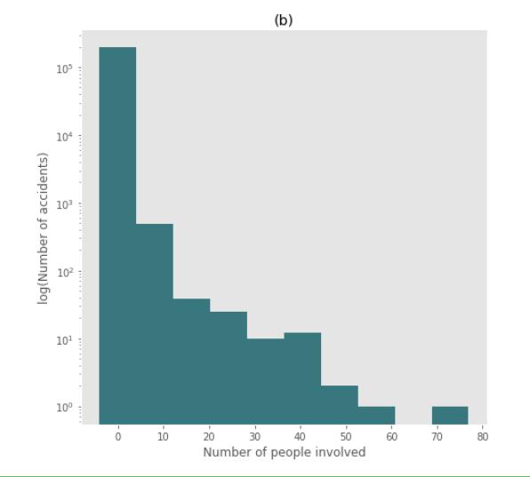
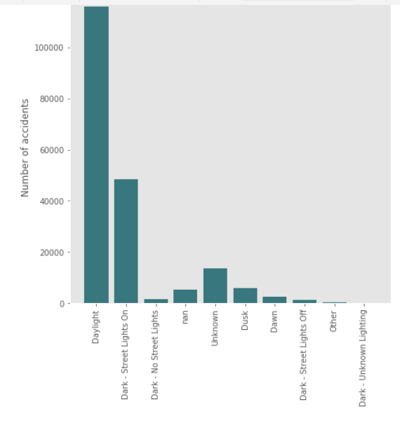
Results
We visualized the data on the major factors which are likely to play a role in accident severity
Majority of accidents are property damage only collisions.
Number of people involved in accidents range from 0-5 (most) to 60.
Most accidents happen at clear weather condition.
Most accidents happen at daylight or at night with street light on.

Slide 6
Discussion
Most crashes happened in clear, dry, and bright conditions.
This is likely due to the factors that during these conditions, traffic are higher and hence the likelihood of traffic accidents may increase.
It is also found that crashes with a distracted driver or an impaired driver are more likely to result in injury.
Certain neighbourhood/road junctions are also likely to have higher incidence of car accidents
The results of the data indicate to city planners and traffic police that during ‘ideal’ driving conditions, drivers should be more alert on the surroundings and practice defence driving.

Slide 7
Conclusion
Due to the complexity of multiple factors involved, prediction of car accident severity may depend on various machine leaning factors and can be a combined effect include traffic condition, location, road conditions etc.
Through the Capstone project, I have learned to handle a real-world data with complexity. Various techniques from previous modules have been applied and I have benefited tremendously from doing this project.

